Slide 1

Prediction of Students’ Dropout and its Influential Parameters
Nandhini Natrayan
Yaren Merve Akin

Slide 2
About Dataset
We have selected the University student performance dataset for analysis and prediction
The dataset includes information about the student's educational, parental, and financial backgrounds, as well as their academic performance
By training the model using the dataset provided, we evaluate its accuracy by using the test data
Finally, we utilize the best-trained model to predict the academic success of unseen data

Slide 3

Goal of the Project
Our objective is to identify the factors that influence student dropout using Machine Learning (ML)
Evaluate the use of ML model to predict the student dropout

Slide 4

Assumptions
Our target variable has 3 labels
Graduate (0)
Dropout (1)
Enrolled (2)
For the train and testing purposes of the model we used the 0 and 1 label rows
For the prediction we used the 2 label rows as unseen data

Slide 5
Project Overview
Data Preprocessing : EDA
Feature Selection
Label Encoder
Balancing the data using SMOTE
Model creation
Grid search
Prediction using model

Slide 6

Exploratory Data Analysis(EDA)
Rename the column
Feature selection
Dropping irrelevant rows
Histogram
Heatmap Analysis
Multivariate Analysis
Variable Transformation

Slide 7
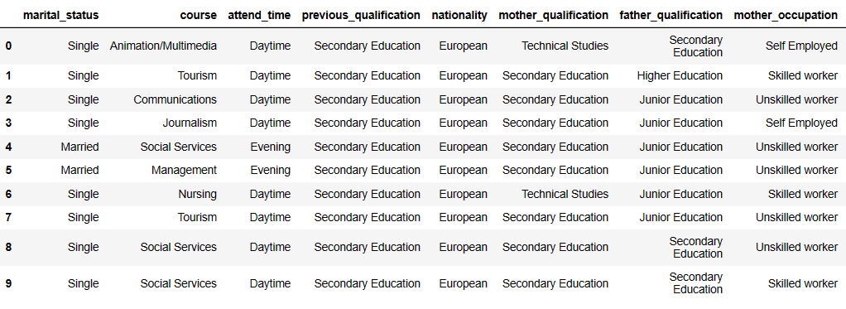
Before Label Encoder

Slide 8
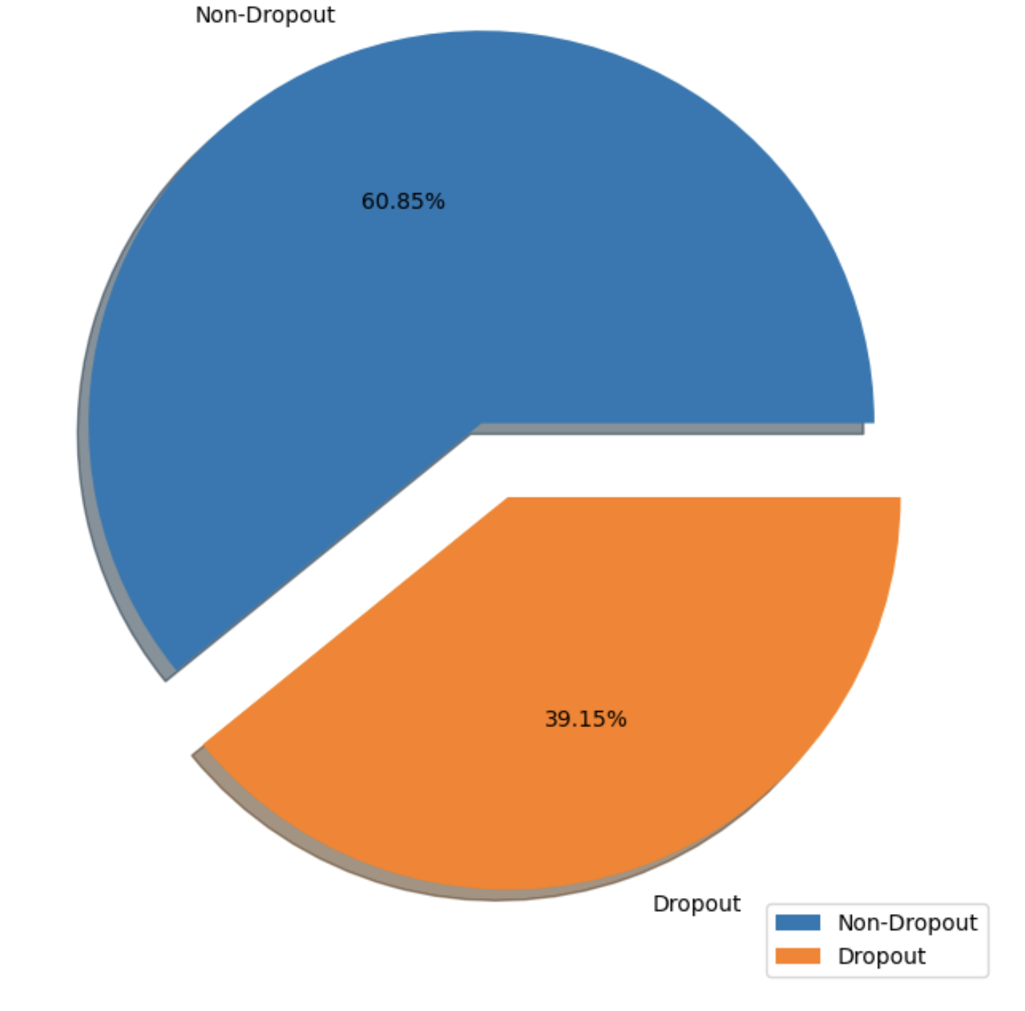
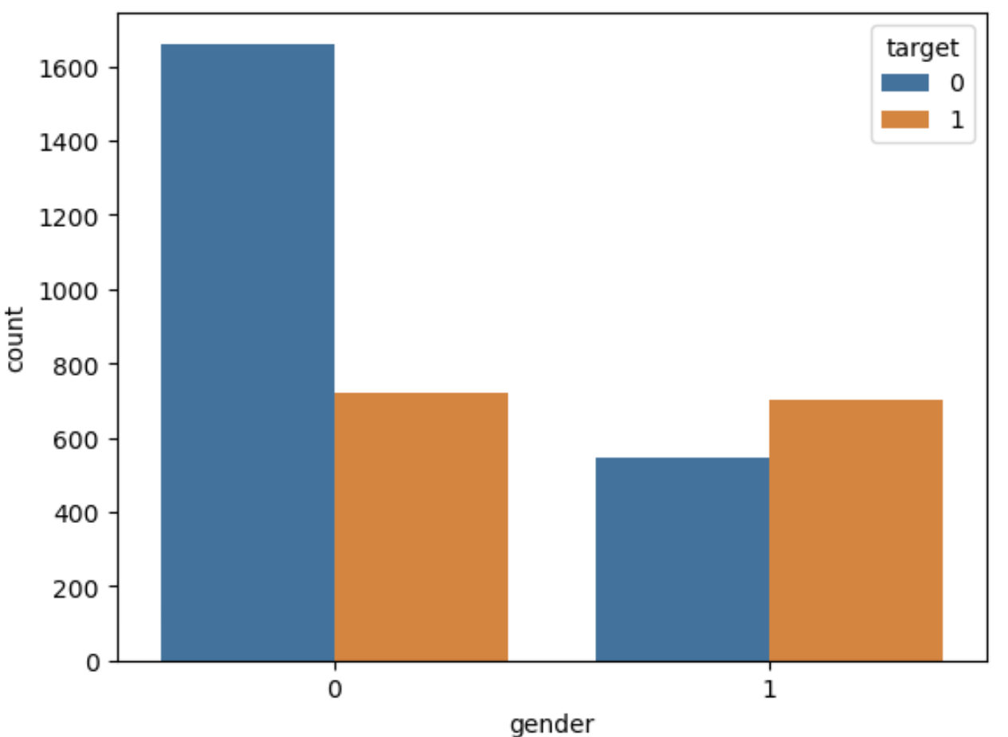
Data Visualization
Distribution of target variable
Dropout Rate by Gender

Slide 9
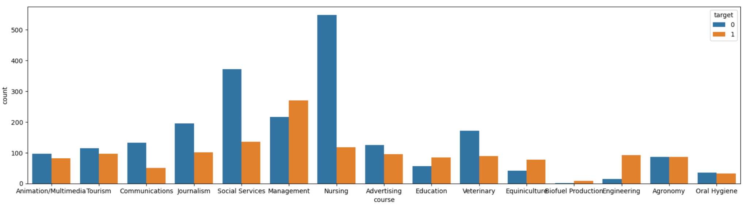
Dropout Rate by Courses
Data Visualization

Slide 10
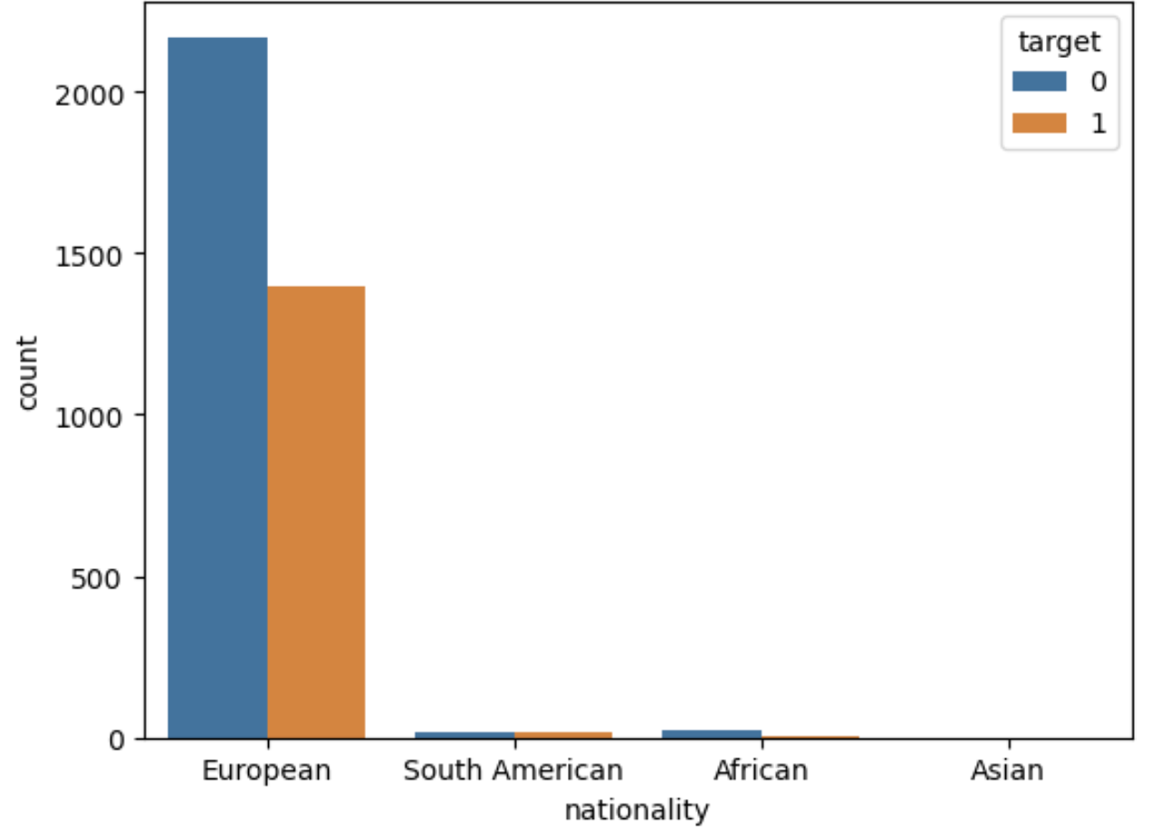
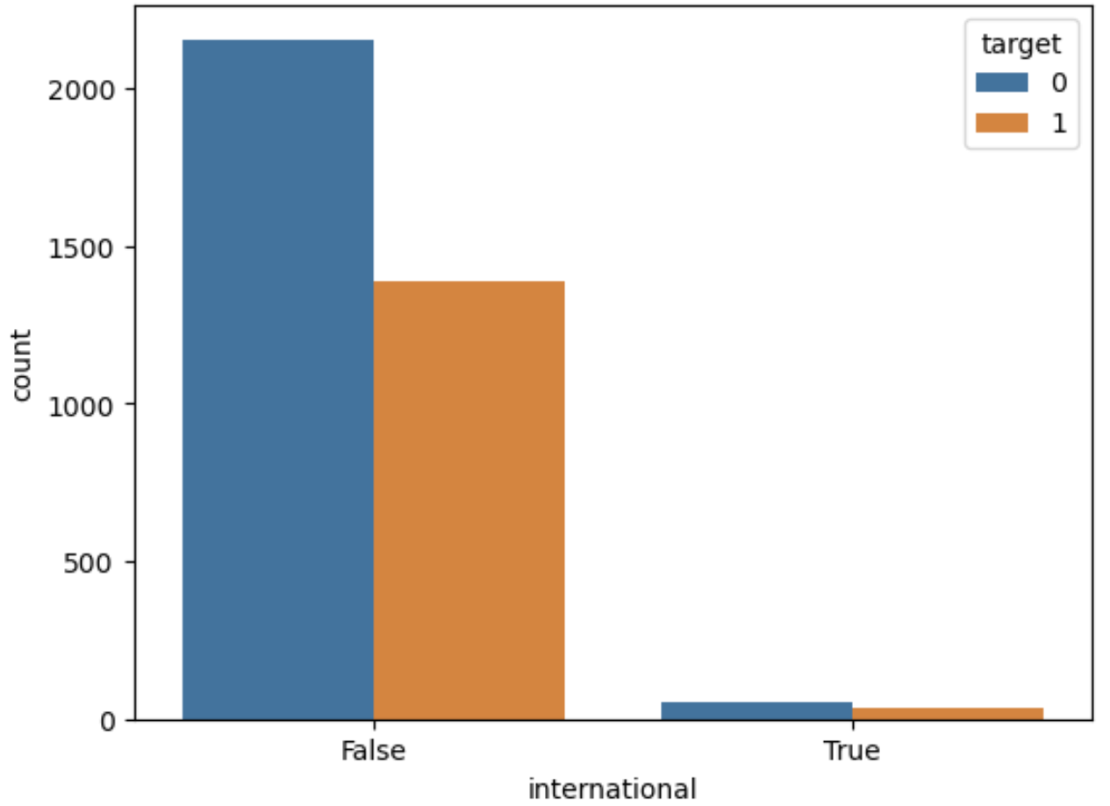
Dropout Rate by Origin
Data Visualization

Slide 11
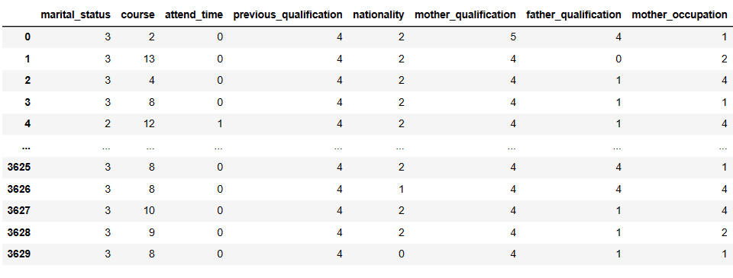
After Label Encoder

Slide 12
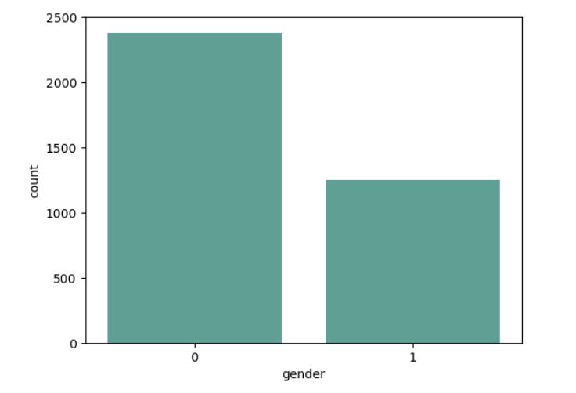
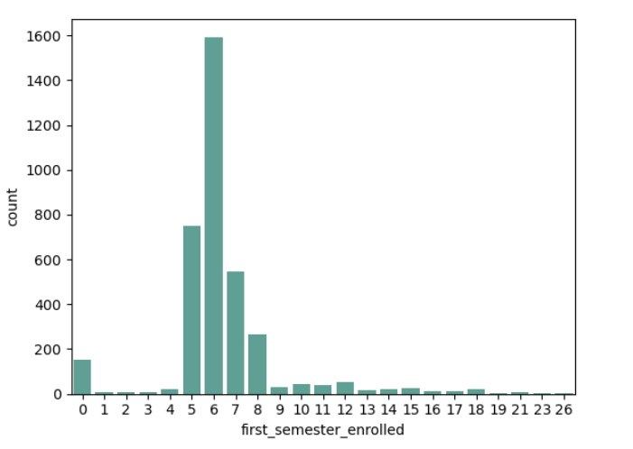
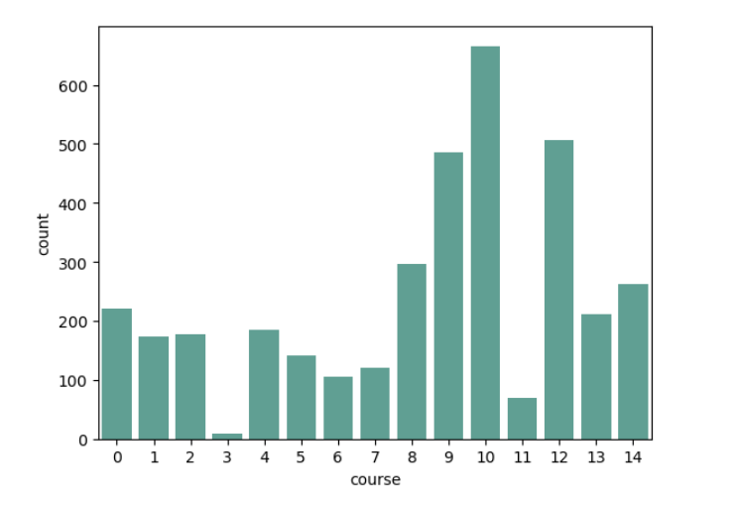
Histograms

Slide 13
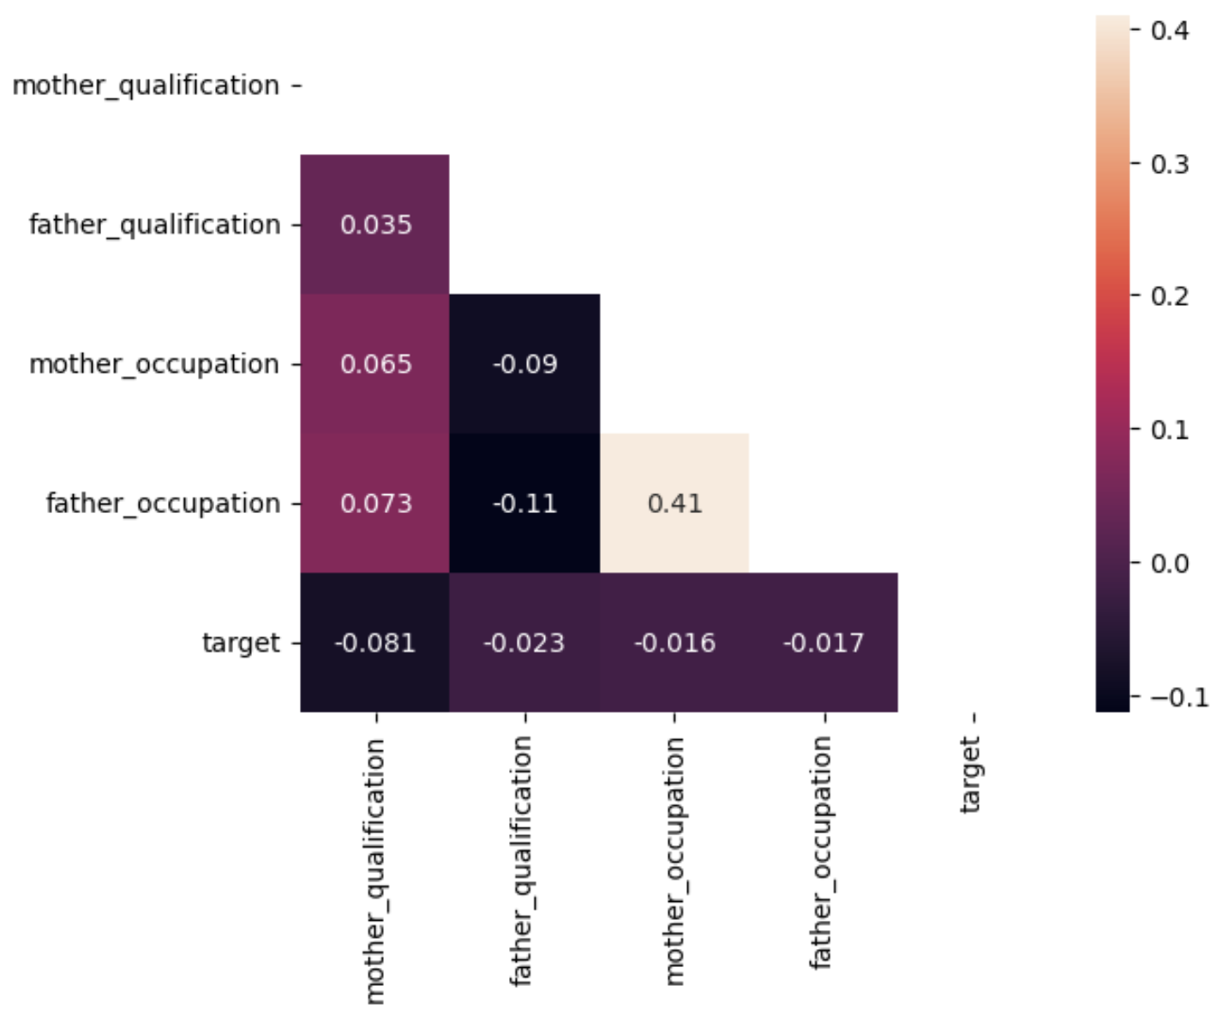
Heatmap Analysis for the Parents’ Background

Slide 14
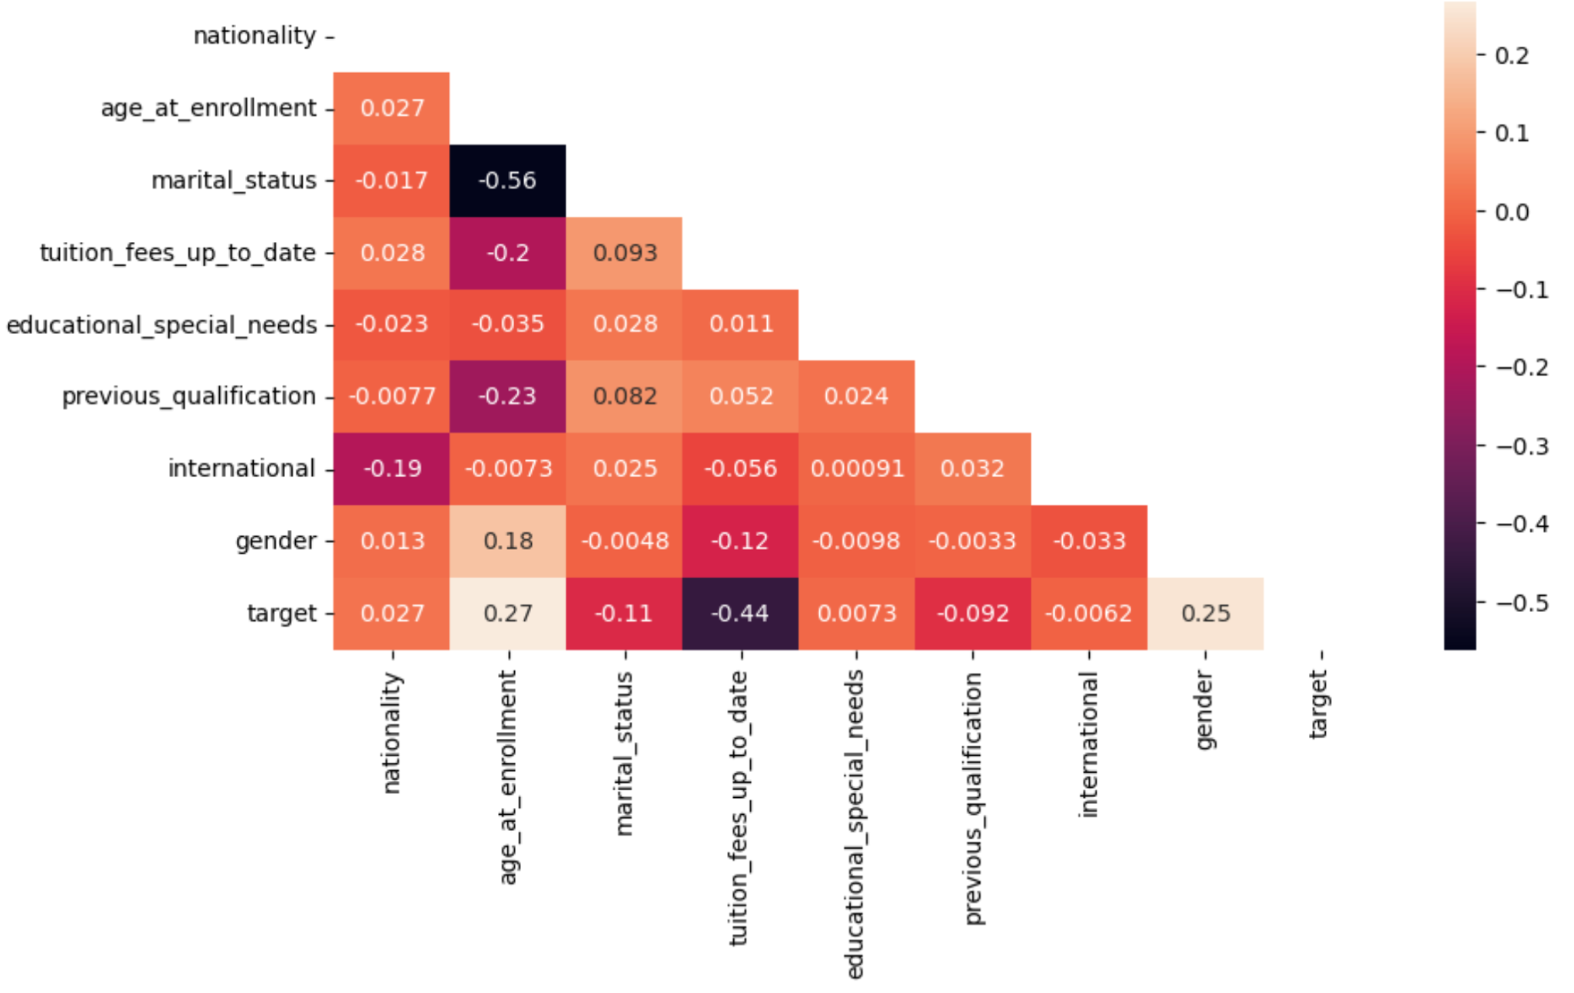
Heatmap Analysis of the Students’ Background

Slide 15
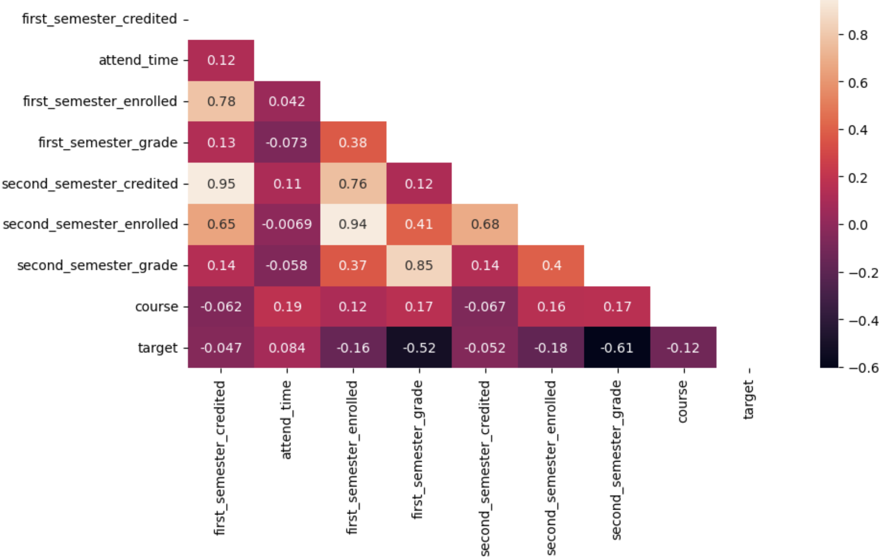
Heatmap Analysis of the Students Academic Performance

Slide 16

Training the Model
We have imbalanced dataset
Used SMOTE to balance it
Outcome for balancing the model and advantages
GridSearch

Slide 17
Model Comparison
Before Balancing |  |  |  |  |  |  | After Balancing
MODEL | Accuracy |  | Precision |  | Recall |  | MODEL | Accuracy |  | Precision |  | Recall
 | Train | Test | Train | Test | Train | Test |  | Train | Test | Train | Test | Train | Test
LR | 0.84 | 0.83 | 0.87 | 0.85 | 0.72 | 0.67 | LR | 0.92 | 0.79 | 0.91 | 0.72 | 0.93 | 0.71
KNN | 0.9 | 0.82 | 0.92 | 0.78 | 0.82 | 0.64 | KNN | 0.87 | 0.86 | 0.91 | 0.84 | 0.82 | 0.78
DT | 0.87 | 0.87 | 0.95 | 0.91 | 0.74 | 0.71 | DT | 0.88 | 0.85 | 0.94 | 0.83 | 0.81 | 0.74
RF | 0.88 | 0.85 | 0.92 | 0.87 | 0.76 | 0.71 | RF | 0.87 | 0.86 | 0.91 | 0.84 | 0.82 | 0.78
ADB | 0.91 | 0.88 | 0.93 | 0.88 | 0.83 | 0.77 | ADB | 0.93 | 0.87 | 0.95 | 0.85 | 0.91 | 0.78
XGB | 0.92 | 0.89 | 0.9 | 0.87 | 0.94 | 0.93 | XGB | 0.94 | 0.87 | 0.94 | 0.88 | 0.95 | 0.92

Slide 18
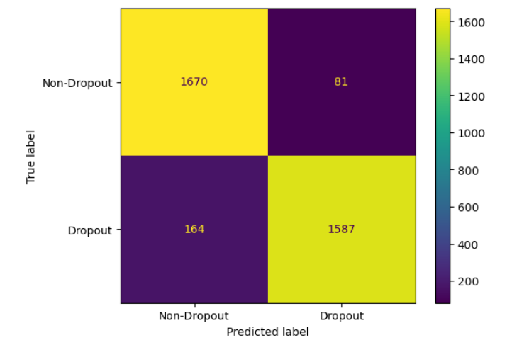
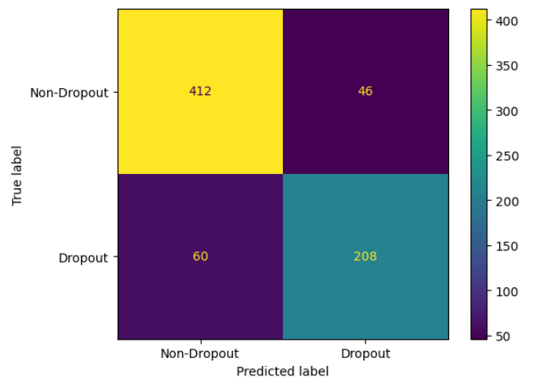
Confusion Matrix(XGBoost)
Train
Test

Slide 19
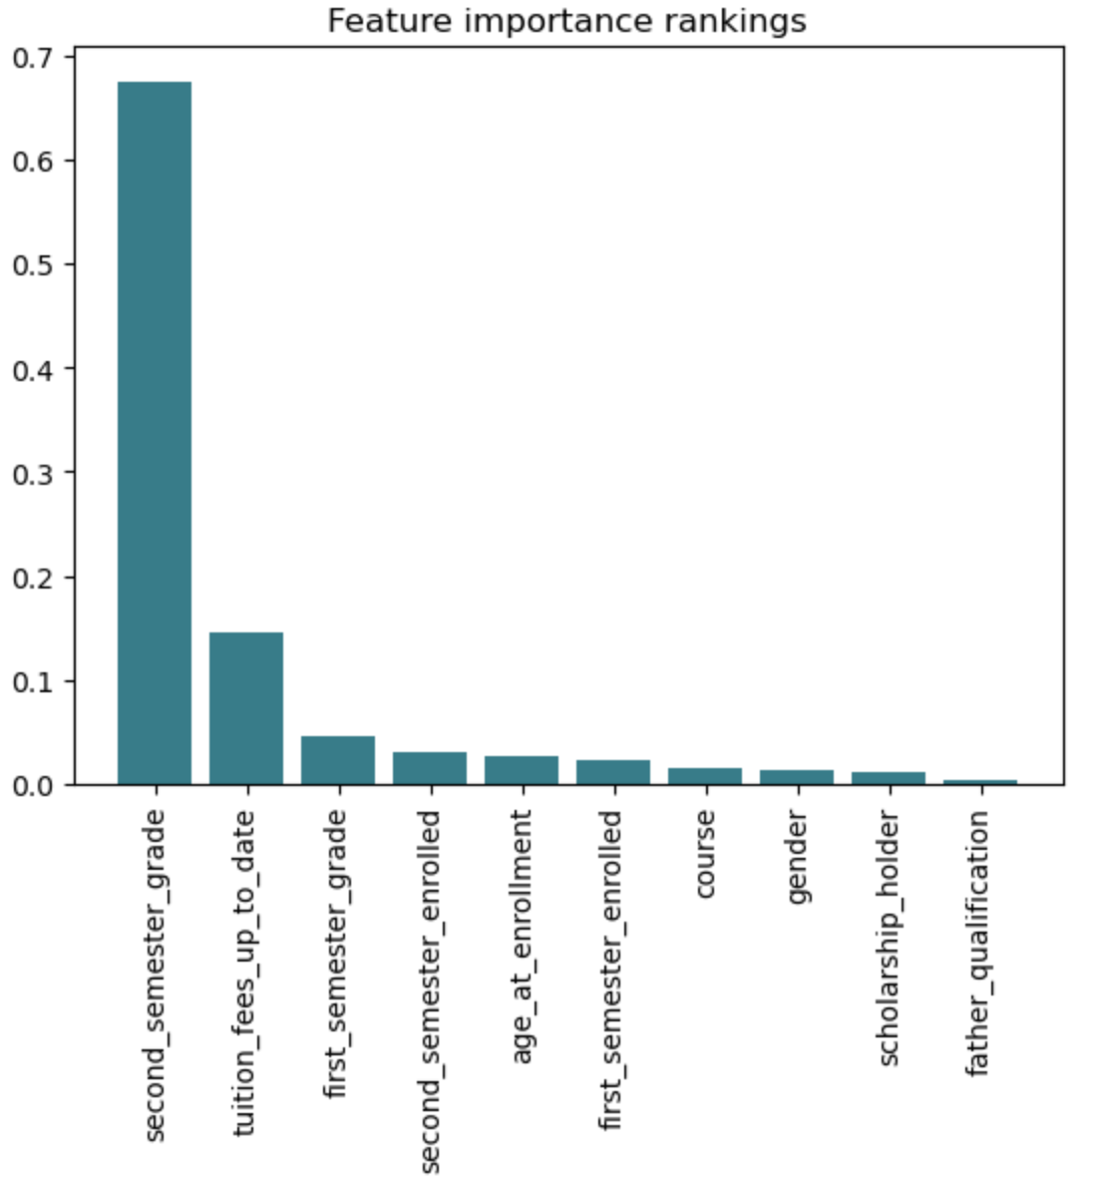
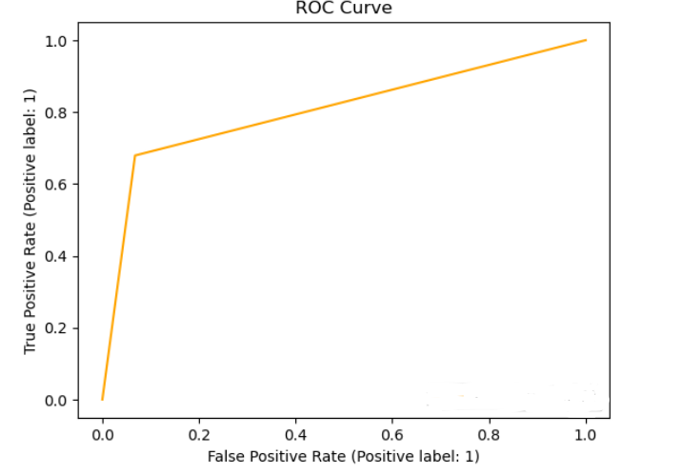
Feature Importance for the XGBoost Model

Slide 20
Hypertuning Parameter(GridSearch)
There are 3 important hyperparameters in our Model
Learning Rate
N_estimator
Max_depth
Learning Rate=1
N_estimator=200
Max_depth=20

Slide 21
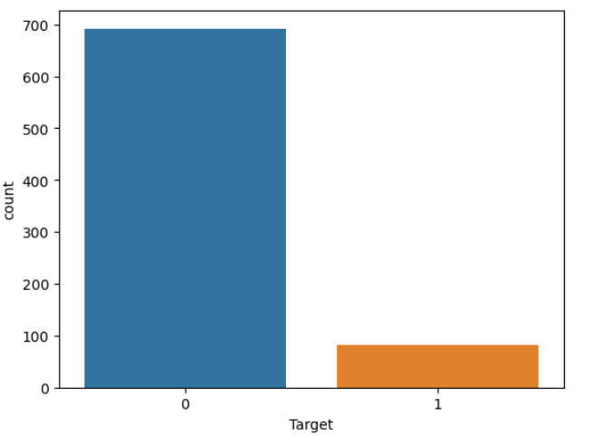
Model Prediction
0-Non-dropout
1-Dropout
10% student Dropout

Slide 22
Insights
Academic performance has a greater impact on student dropout rates
Among different models the XGBoost model has achieved the highest accuracy for test.
In model predictions, it is crucial to find the optimal parameters.
The test dataset contains the target variable for the enrolled students. To predict the student going to dropout or not by using our model.Our model is expected to predict 90% accuracy for unseen data
-

Slide 23
Recommendations
Early warning and intervention
Obtaining student feedback
Personalized guidance and counseling
Financial aid and scholarships

